Slide 1
RUNGTA COLLEGE OF DENTAL SCIENCES & RESEARCH
TITLE OF THE TOPIC: TRAUMATIC INJURIES
DEPARTMENT OF CONSERVATIVE DENTISTRY AND ENDODONTICS

Slide 2
Specific learning Objectives
At the end of this presentation the learner is expected to know
Core areas* H | Domain ** | Category #
Classification of fractures,etiology of fractures complicated and uncomplicated crown fractures, | Cognitive | Must know
Clinical examination of tooth fracture, Avulsion | Psychomotor | Nice to know
Luxation injuries, root fracture | Affective | Desire to know
*Subtopic of importance
** Cognitive, Psychomotor or Affective
# Must know , Nice to know & Desire to know

Slide 3
Table of Content
Introduction
Classification
Etiology and causes
Clinical examination
Enamel fractures
Uncomplicated crown fracture
complicated crown fracture
Crown root fracture
Root fracture
Luxation injuries
Avulsion
conclusion

Slide 4
Crown fracture (complicated)
0.9 to 13% - all dental injuries
Consequence
First 24 hrs – proliferative response with inflammation not extending more than 2mm into pulp
Treatment
Vital pulp therapy
Pulpectomy

Slide 5
Factors affecting treatment selection
Time
Attachment damage
Restorative treatment plan
Level of development
VITAL PULP THERAPY
PULP CAPPING
- no absolute indications
- a bacteria tight coronal seal more difficult
- 80% success rate

Slide 6
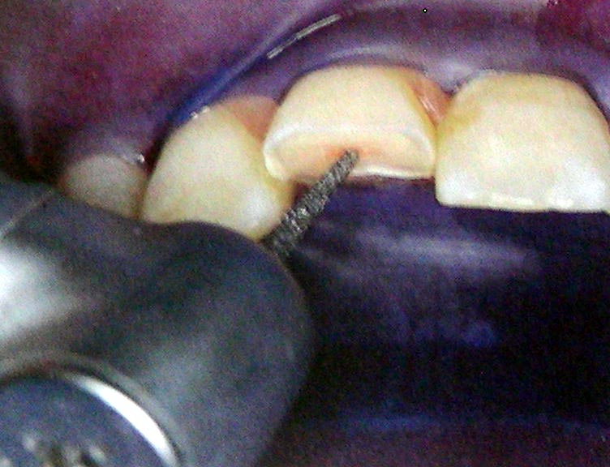
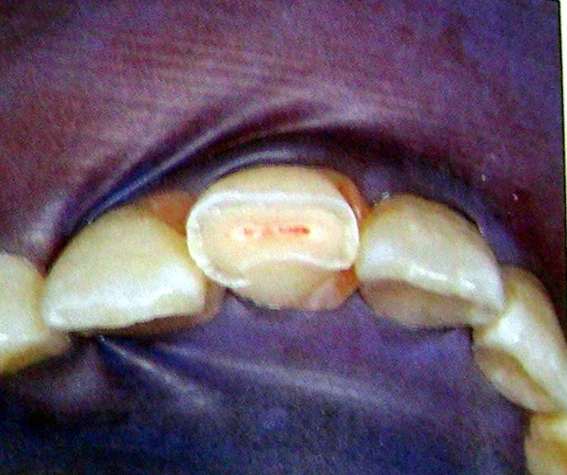
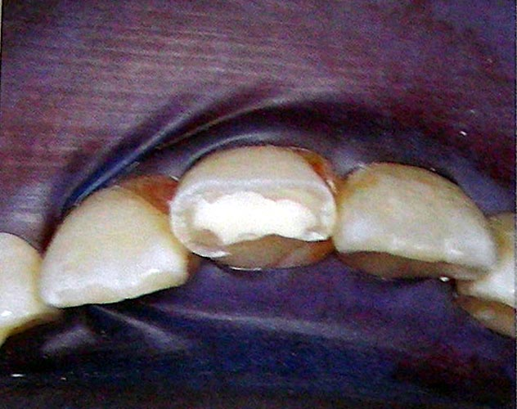
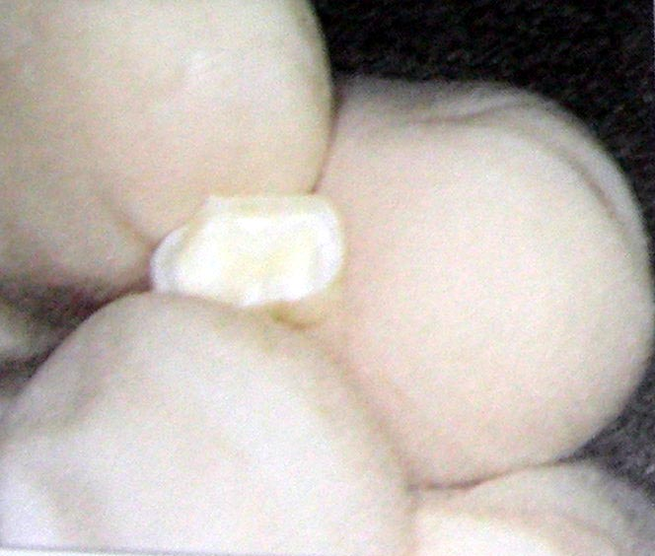
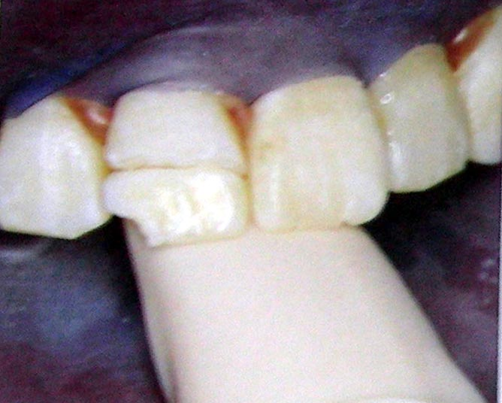
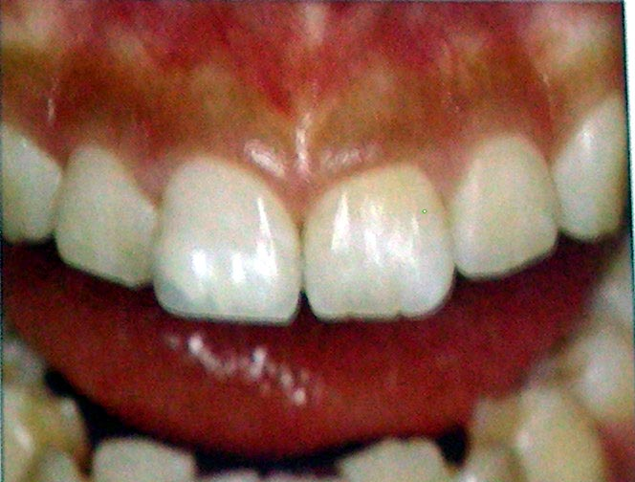
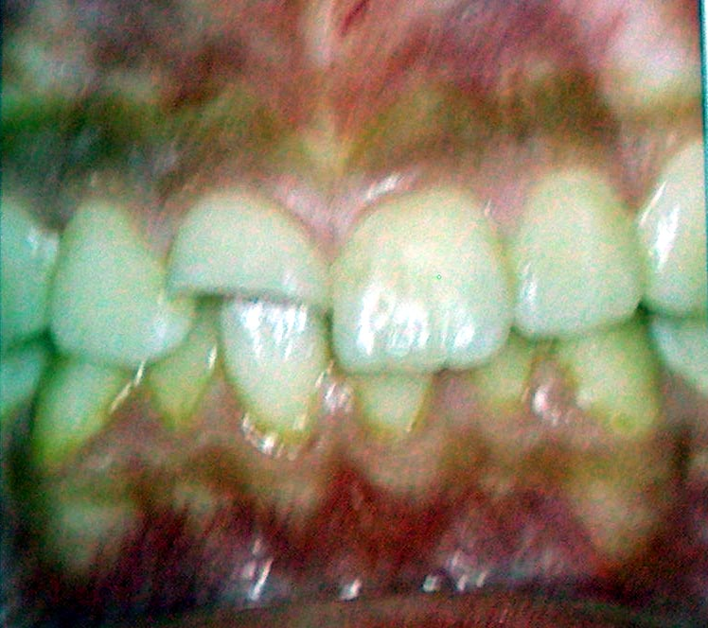
PARTIAL PULPOTOMY
Shallow or CVEK pulpotomy
Advantage over deep pulpotomy
Procedure
Prognosis – 94 to 96%

Slide 7
Material of choice
CaOH or MTA
The reparative dentin is consistently more uniform and thicker under MTA compared with CaOH
Heide And Cvek – Safe to proceed with shallow pulpotomies upto 1 week post fracture

Slide 8
FULL PULPOTOMY
Traumatic exposures after 72 hours
Technique
Prognosis – 75%
Contraindicated – mature teeth
pulpectomy has a success rate 95%, whereas if apical periodontitis develops, the prognosis of RCT drops to 80%.

Slide 9
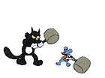
Other treatments
Pulpectomy
Apexification procedures
Pros and cons
CaOH apexification MTA apexification

Slide 10
CROWN – ROOT FRACTURE
Complicated and uncomplicated
Treatment modalities
Reattachment
Restorative Treatment

Slide 11
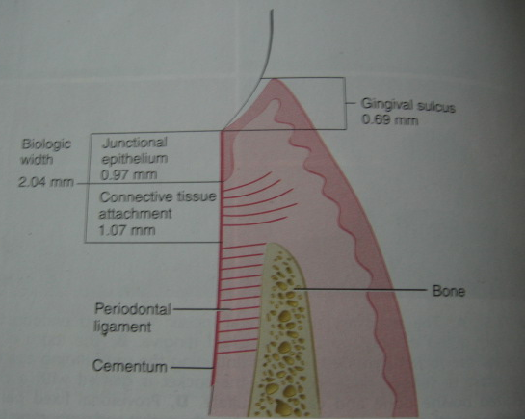
Crown root fracture and biological width
Biological width – connective tissue attachment + junctional epithelium
Andersean et al – 4mm tooth structure above crest of alveolar bone
Methods
Periodontal surgery
Surgical extrusion
Orthodontic extrusion

Slide 12
Periodontal surgery
Apically repositioned flap surgery
esthetics??
When to go for gingivectomy???

Slide 13
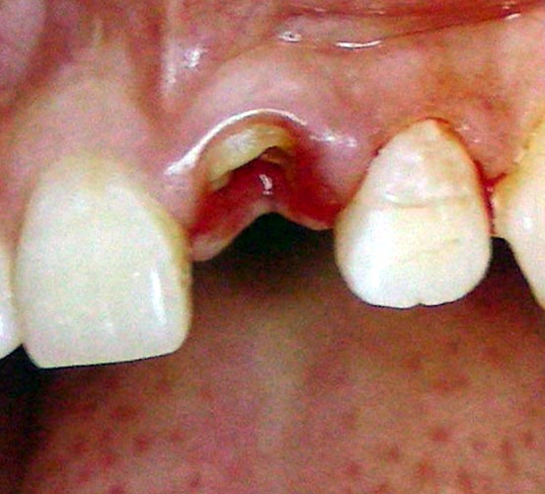
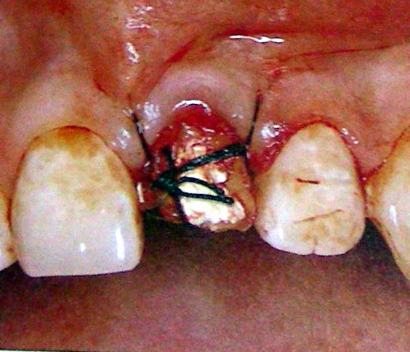
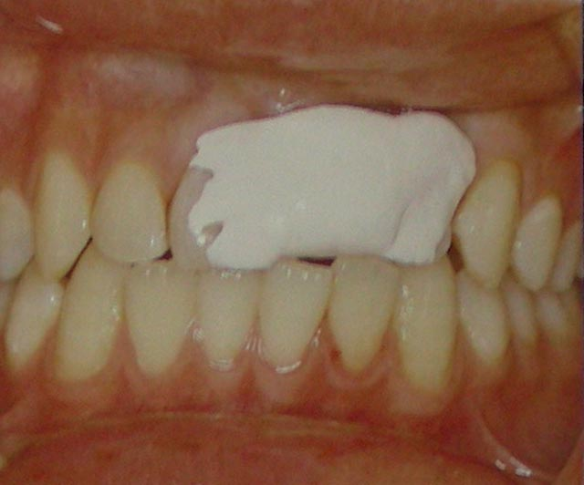
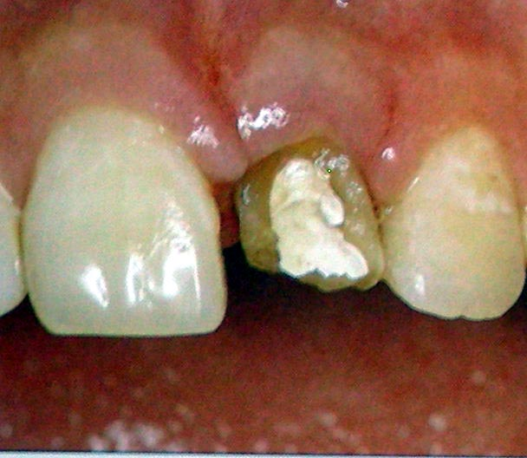
Surgical extrusion (intra-alveolar transplantation)
Procedure

Slide 14
Procedure ( Kahnberg techniques )
1st method
- flap operation with apical exposure
- bone transplant above the root after exposure
2nd method
- extrusion by marginal luxation and stabilization by interdental suturing

Slide 15
Advantages
Disadvantages
surgical extrusion of average 4.25mm ( 3 – 7mm) can be performed without any complication and good long term success (caliskan et al ’99 )

Slide 16
Healing after surgical extrusion

Slide 17
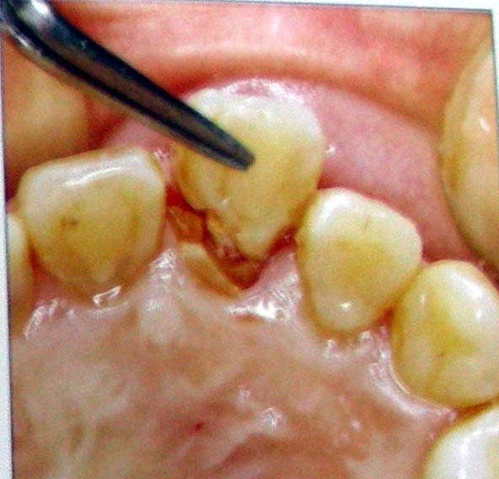
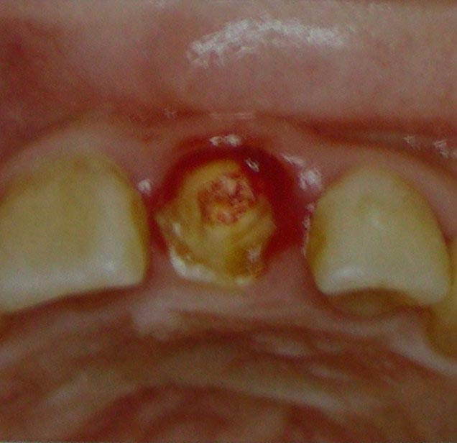
Orthodontic extrusion
Slow or forced extrusion
Procedure

Slide 18
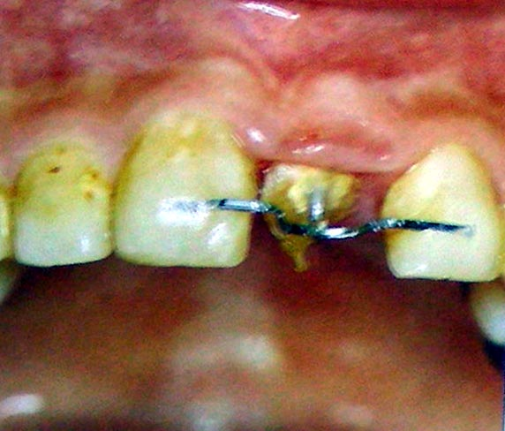
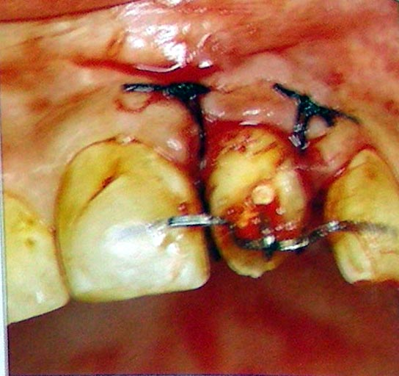
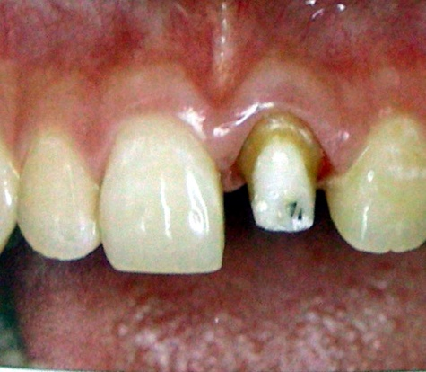
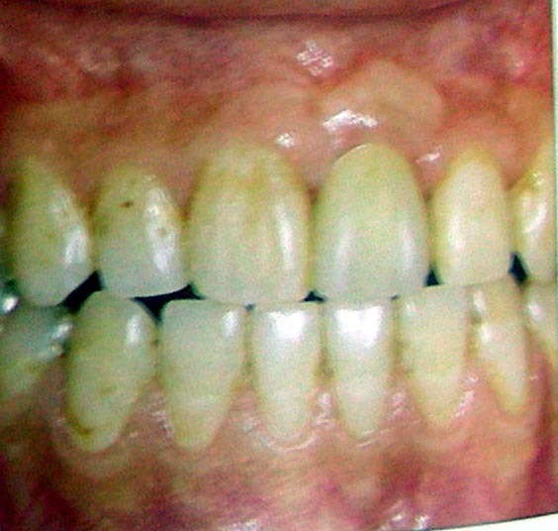
Time of treatment – 4 to 6 weeks
Stabilisation – 6 weeks

Slide 19
Orthodontic extrusion with supracrestal fibrotomy ( Ami Smidt et ’05 )
Force required –
25 to 30 g ( Reitan and Vanarsdall ’94 )
50 to 75 g ( Profitt and Fields ’93 )

Slide 20
Cracked tooth syndrome
Type of crown root fracture
Classification
A - crack involving enamel and dentin without pulp involvement
B - incomplete fracture of crown involving pulp but not periodontal tissue
C - incomplete fracture of crown involving pulp and periodontal tissue
D - complete division of tooth involving pulp and periodontal tissue
E - apically induced fracture ( vertical fracture )

Slide 21
Diagnosis
Mild to excruciating pain – initiation
or release of biting pressure
Orangewood, tooth slooth, Frac finder
Management:
A – composite, FVC
B and C – RCT and FVC
D – hemisection or extraction
E – extraction, hemisection or root resection

Slide 22
Vertical fracture
Type of crown root fracture
Clinical diagnosis
Crack probing
Selective sensititvity
Restorative treatment
Multiple sinus tract
Dental operating microscope
Surgical exposure
Transillumination and dyes

Slide 23
Radiographical evaluation
Detected – 35.7%
Radiographic signs
Cement trail
Halo like bone loss
Isolated bone loss
others – widened canal space, radiolucency between obturation and canal walls, bone loss mesial or distal to the roots
Periodontal evaluation
isolated, deep and narrow pocket
V shaped pattern of bone loss

Slide 24
Treatment
hemisection, root resection
extraction should be considered
Treatment by bonding fragments and rotational replantation
(Kawai Masaka et al.’02)

Slide 25
Root fracture
Types – transverse or oblique
single or multiple
complete or incomplete
Radiographs – angled within 4 degrees of fracture line
Additional radiograph at 45 degrees ( INGLE )
At least 3 angled radiographs – 45, 90 , 110 degrees
( COHEN )

Slide 26
Displacement - none to severe
Biological consequence
pulp necrosis of coronal part – 25%
pulp necrosis of apical part – rare
Emergency treatment
a. Repositioning – finger pressure or orthodontic intervention
b. Splinting - 2 to 4 weeks

Slide 27
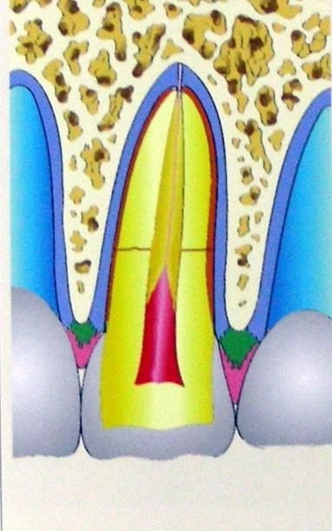
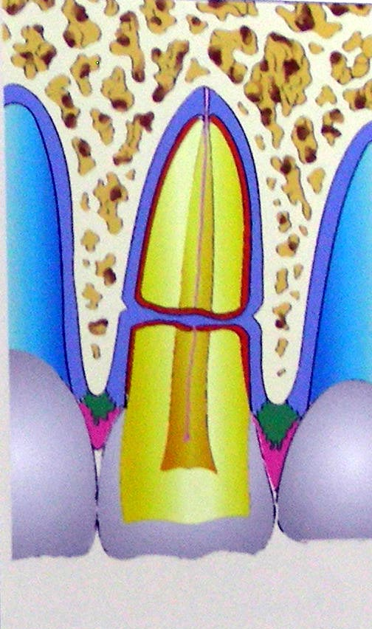
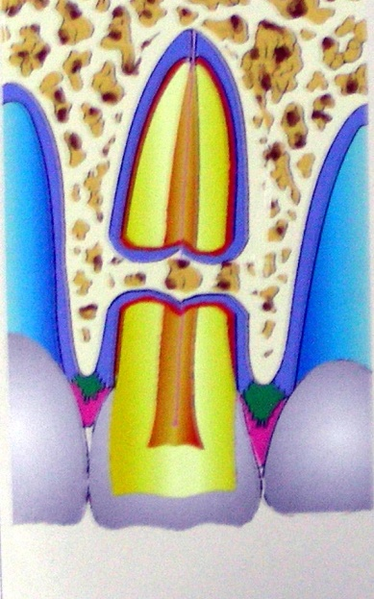
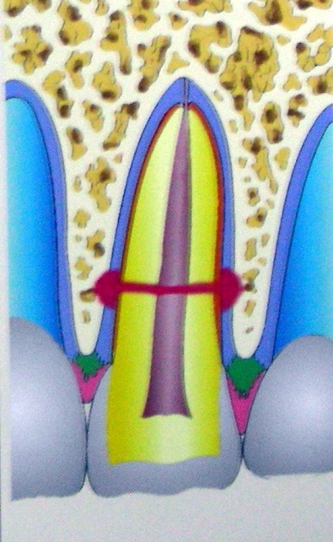
Healing pattern of root fractures
(Andresean and Hjorting-Hansen)
Healing With Calcified Tissue
Healing with interproximal connective tissue
Healing with interproximal bone and connective tissue
Interproximal inflammatory tissue without healing
First 3 types - success

Slide 28
TREATMENT OPTIONS
Root canal therapy of both segments
Root canal treatment of coronal segment alone
Use of intraradicular splint
Root extrusion
Cvek modification of root canal therapy of coronal segment alone

Slide 29
Prognosis
- amount of dislocation, stage of root development and quality of treatment.
Fracture location on prognosis
More apical the fracture, better the prognosis
MISCONCEPTION
- location did not influence outcome
( Zachrisson and Jacobsen )
- fracture location matters less as long as it is not too close to the alveolar crest
( Jacobsen )

Slide 30
Complications
Pulp necrosis
Pulp canal obliteration
Yellowing effect with reduced transparency – healed root fractured teeth

Slide 31
Luxation injuries
Largest group – 30 to 44%
Includes
1. Concussion
2. Subluxation
3. Extrusive luxation
4. Lateral luxation
5. Intrusive luxation
6. Avulsion

Slide 32
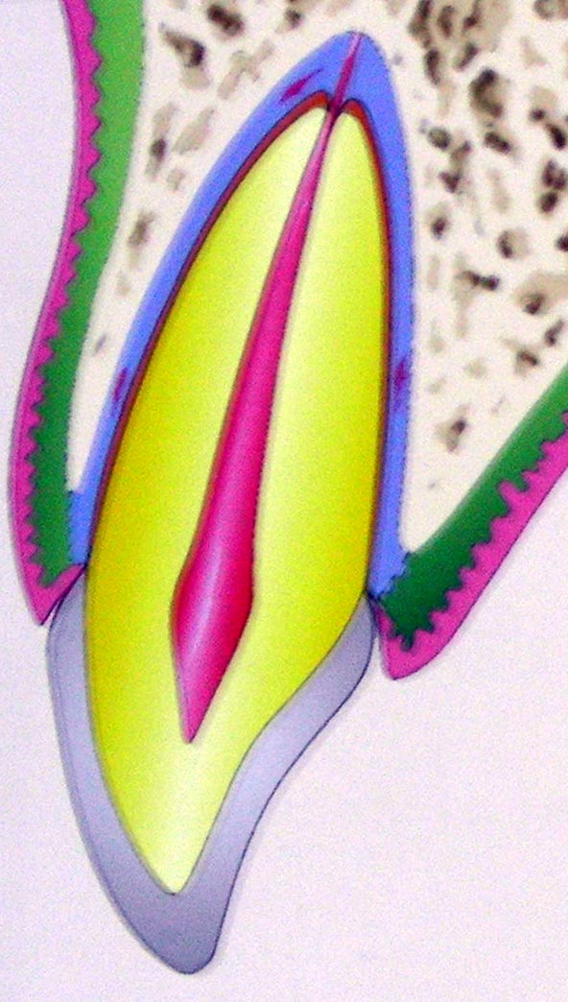
concussion
No displacement
Normal mobility
Sensitivity to percussion
Management
symptomatic
D. Diagnosis
root fracture, subluxation

Slide 33
Teaching Materials
Endodontic practices - Grossman
Pathways of pulp – Cohen
Textbook of Endodontics – Nisha Garg
Endodontics - Ingle

Slide 34
TAKE HOME MESSEGE/ FOR THE TOPIC COVERED (SUMMARY)
Various factors influence the outcome of teeth that had undergone trauma.
Correct diagnosis, quality and timeliness of initial and long term treatment can improve the prognosis of the traumatized teeth.

Slide 35
Question & Answer Session
Cracked tooth syndrome?
Treatment for vertical fracture

Slide 36
REFERENCES
Endodontic practices - Grossman
Pathways of pulp – Cohen
Textbook of Endodontics – Nisha Garg
Endodontics - Ingle

Slide 37
THANK YOU

